Slide 1
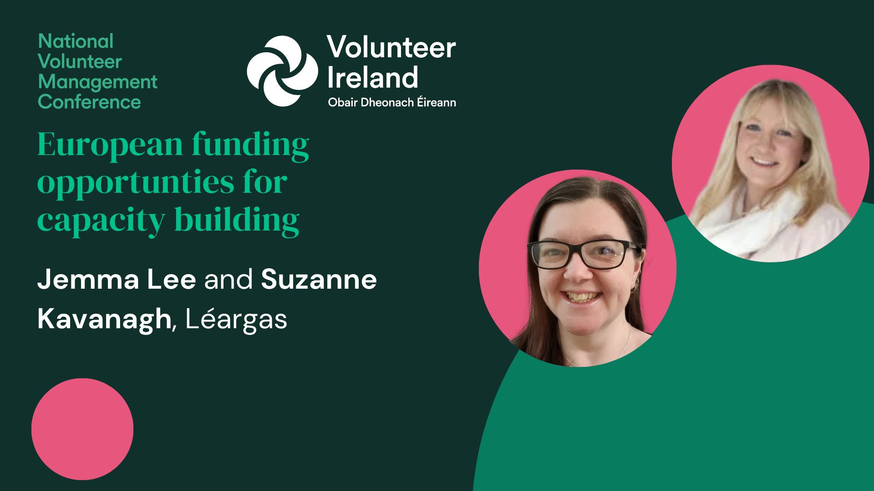

Slide 2
European Funding Opportunities for Capacity Building
National Volunteer Management Conference

Slide 3
Léargas manage national and international programmes in youth work, volunteering, sport, education and training including Erasmus+, European Solidarity Corps and eTwinning

Slide 4
Schools Education
Adult Education
Sport
Youth
Vocational Education & Training
European Solidarity Corps Volunteering

Slide 5

Programme Priorities
Participation in democratic life, common values and civic engagement
Inclusion & Diversity
Digital Transformation
Environment
and fight against climate change

Slide 6



Over to You:
Your Name
Your Organisation

Slide 7
European Solidarity Corps- Volunteering
Benefits to Organisations
Entry into the programme is through a single point- Quality Label.
ESC Quality Label lets you define your organisation objectives, targets and budgets in compliance with the principles, objectives and quality standards of the European Solidarity Corps.
Once awarded the Quality Label- direct access to funding until 2027/8
Organisations have a pool of full-time volunteers that are motivated committed and ready to support your work.

Slide 8
The European Solidarity Corps – State of Play in Ireland
Volunteering Projects
64 organisations/ 42 active organisations
Representing Youth, Social Justice, Community Engagement, Arts and Heritage.
2024​ | Volunteering Projects​ | Solidarity Projects​
Applications received ​ | 23​ | 17​
Selected​ | 23​ | 12​
Budget Allocation​ | €1,560,392​ | €91,066​

Slide 9
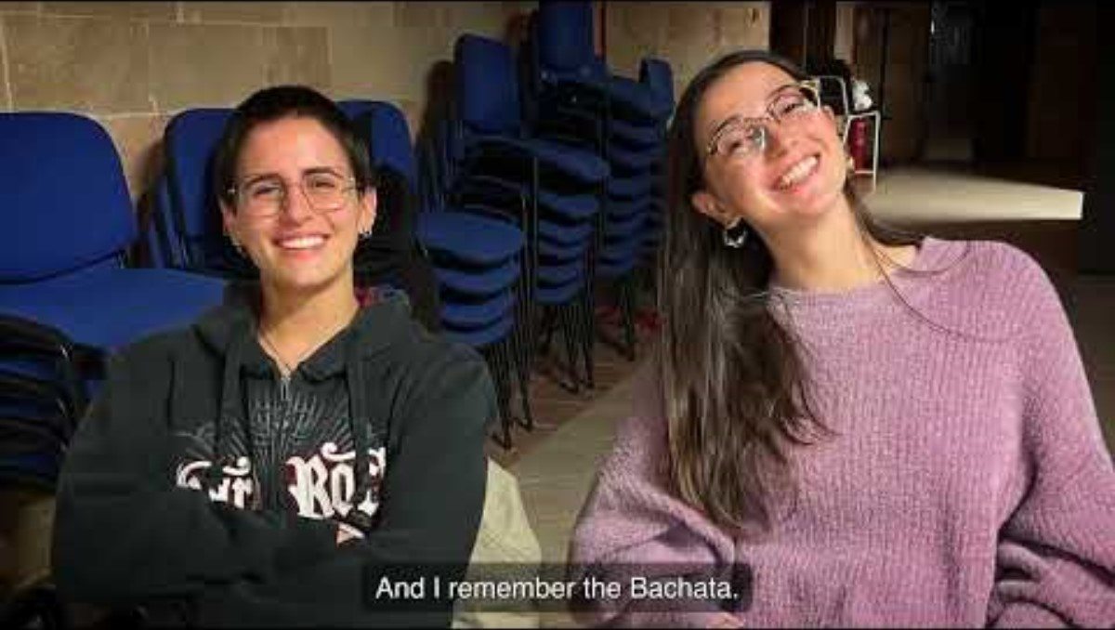
ESC Solidarity
Seen and Heard '24

Slide 10

Adult Education in Erasmus+
All forms of
non-vocational
adult education, whether of a formal, nonformal
or informal nature

Slide 11




























Slide 12
Sample Project – South Leinster Citizens Information Service
Job
Shadowing
Regional Events
Embedding Learning
12 Month Project
6 Participants – 3 Days
€10,200
Six Citizens Information Service Managers travel to Sweden to learn from practices there.
Those who travelled will share their learning with staff and volunteers across the region.
Implementing new ideas in practice, reviewing and evaluating new practices.
Key Themes
Learn about working with interpreters / translation tools for clients whose first language is not English
Learn new ways to support clients with digital skills, accessing online forms and platforms.

Slide 13

Sample Project – Making Moments Matter, St. Joseph’s Shankhill
Throughout the project
Training Manual
Training Sessions
Volunteer Charter
Project Mgmt Costs, Monitoring & Evaluation
Develop and Publish a Training Manual for others to use to replicate the volunteer programme
Pilot the Training Manual in 10 organisations
Develop a Volunteer Charter that works for both orgs.
Two Partners – Ireland & Portugal
12 Months
€60,000

Slide 14
Over to You:
What are your current goals / challenges
How could a European project support these?

Slide 15


Next Steps…
Sign Up For More Events!
https://www.leargas.ie/training-and-events/
STEP 1
Visit Jemma’s Linktree Page
https://linktr.ee/jemmaleargas
STEP 2
Sign Up For our Newsletters
https://insights.leargas.ie/sign-up-for-the-leargas-newsletter
STEP 3

Slide 16
Thank you.
Jemma Lee| jlee@leargas.ie
Suzanne Kavanagh | skavanagh@leargas.ie

Slide 17


