Slide 1
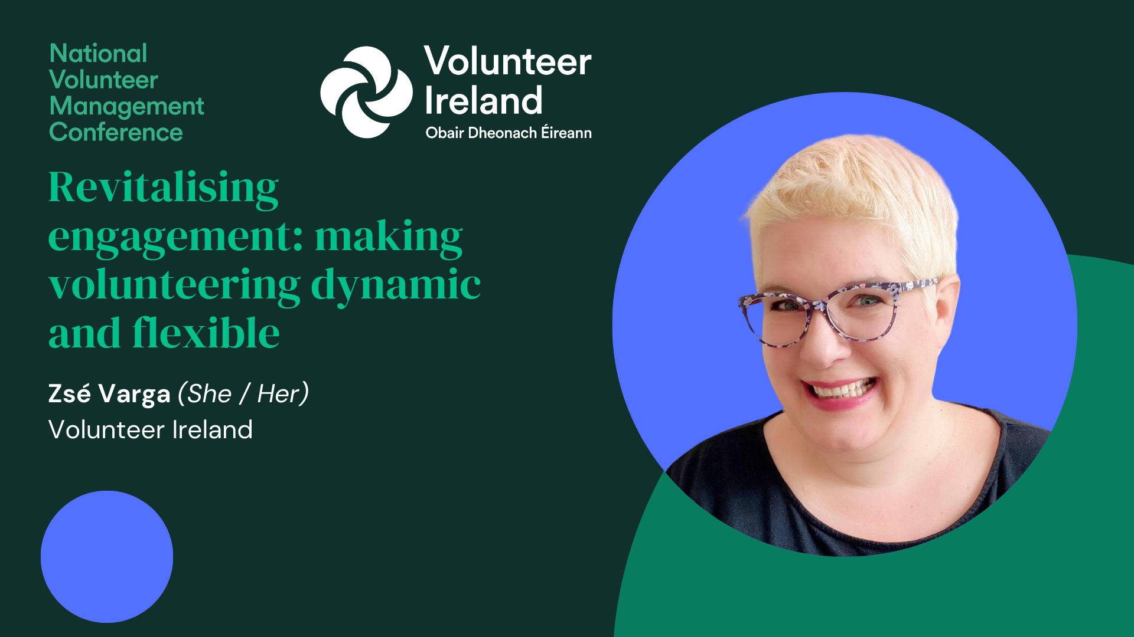

Slide 2

Research on volunteering and volunteer behaviour
Research Report Inclusion in Volunteer Programmes (2024) – Volunteer Ireland and Volunteer Now jointly with DCU
Key findings on Inclusion practices: flexibility as the most mentioned factor
Organisations that can be flexible or adaptable in their roles are more likely to recruit and retain different groups of volunteers
Offering roles that require a low English language requirement may attract new immigrants or asylum seekers who may be excluded from participating in order areas.
Offer roles that appeal to a broad array of skill sets, and allow volunteers the chance to move between roles within the organisation.

Slide 3

Research Report Louth Volunteering Survey 2024
Key finding from volunteers’ answers
“What stops people or hold people back from volunteering”
Not knowing what to expect, not enough information – poor communication by VIO
Stepping forward for a min 3-year role
Not specific enough roles – “generic volunteers required”
Timing not flexible - weekend, once off, short term, remote, etc
There aren’t enough diverse opportunities
There aren’t enough opportunities for diverse groups. (less able bodied people and people whose 1st language isn’t English)

Slide 4
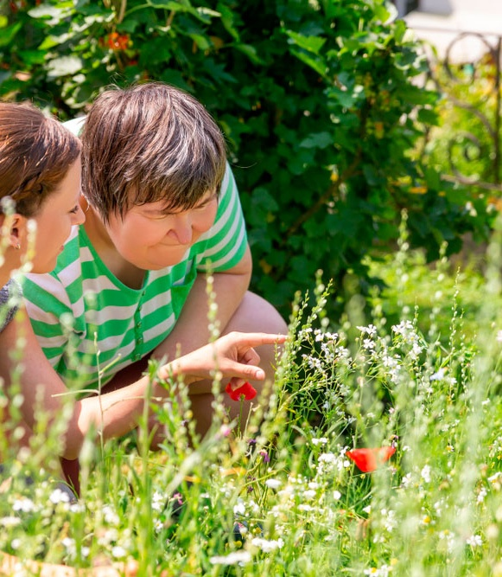
Take a stance
Volunteers are hard to recruit these days.

Slide 5
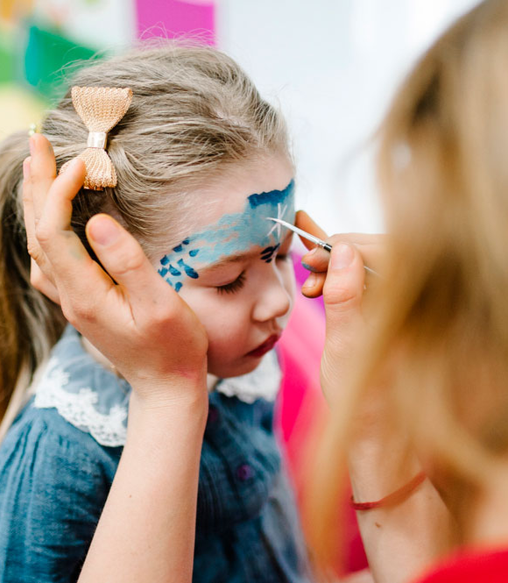
Take a stance
Without volunteers, my organisation’s services would be poorer or not as rich.

Slide 6
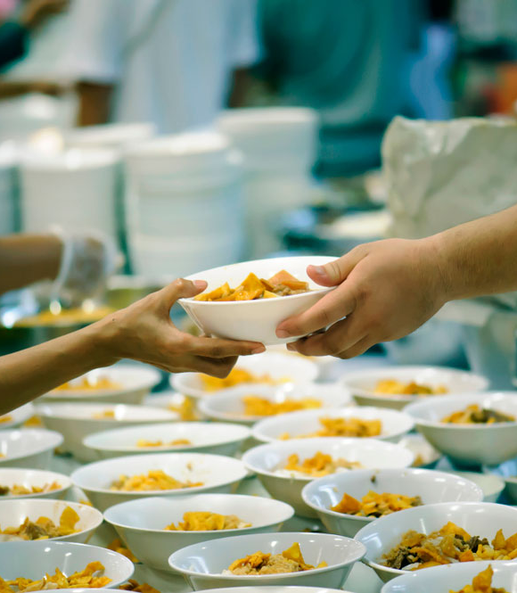
Take a stance
Volunteers should commit to a minimum service time after garda vetting and training, so our time and resource investment is worth it.

Slide 7

Take a stance
We already have some flexibility in our volunteer programme.
.

Slide 8
What flexibility in volunteering is
An overarching concept used to describe new types of volunteering, diverting from the traditional regular volunteering within VIOs.
Examples would be task-based volunteering, virtual and remote volunteering, microvolunteering, short term or once-off and episodic volunteering, etc.
There can be an overlap or combination of these within a single role.
The concept is also referred to as “dynamic volunteering”.
It is a not a new concept, however, it is more prominent in recent years. As it hasn’t been embedded in general use, people mean and understand different things under flexibility in volunteering.

Slide 9
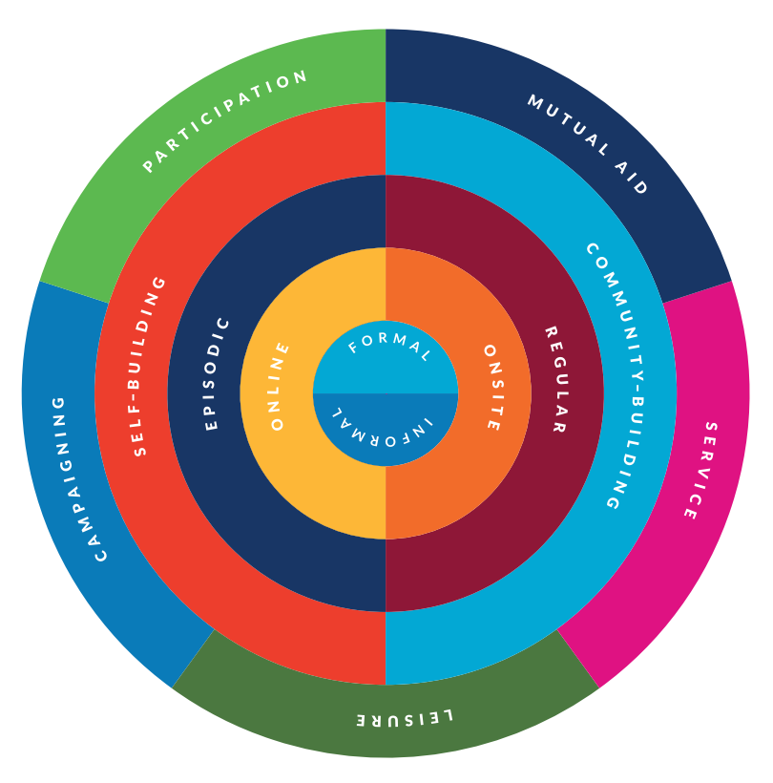
What flexibility in volunteering looks like
UN Volunteers Chart of Dimensions from the Report on “Volunteering Practices in the 21st Century” (2020) Dr. Chris Millora

Slide 10
What flexibility in volunteering looks like
Flexibility in volunteer involving organisations is very much alive and kicking – the more types of roles - the more flexibility found
Often used as a way of rewarding or acknowledging volunteer efforts
Mostly not structurally embedded in to the volunteer programme – within the leaders’ discretion
Sometimes it must be earned

Slide 11

Changing mindsets...
In a world of flexibility
Volunteers’ needs have changed
Those who plan now will reap the benefits of their actions
The biggest barrier is changing the mindsets

Slide 12
Top tips to make your volunteer programme more dynamic
Be more inclusive
Reach out and involve people who are not like you –
young people, people from new communities, people with different abilities/disabilities
Break down barriers
No min 3 years of service expected
Volunteer friendly rosters and times
Buddy system to support inclusion
Create
better-defined volunteer roles
No more “general volunteers required”
Bite-sized/toe-dipping roles
Elevator pitch-able roles
Embrace flexibility
Split roles in two or more
Task-based roles
Remote volunteers
Once-off volunteers
Episodic volunteers
Change in mindset

Slide 13

Making roles more digestible -
Task based and
time bound projects
Break down on-going projects to smaller sized, time bound tasks
Set clear deadlines
Define skill requirements for roles (and provide the necessary training)
Offer flexibility to choose what role volunteers want and when can they do it
Be inclusive
Be open minded and ready to allow new ideas in

Slide 14
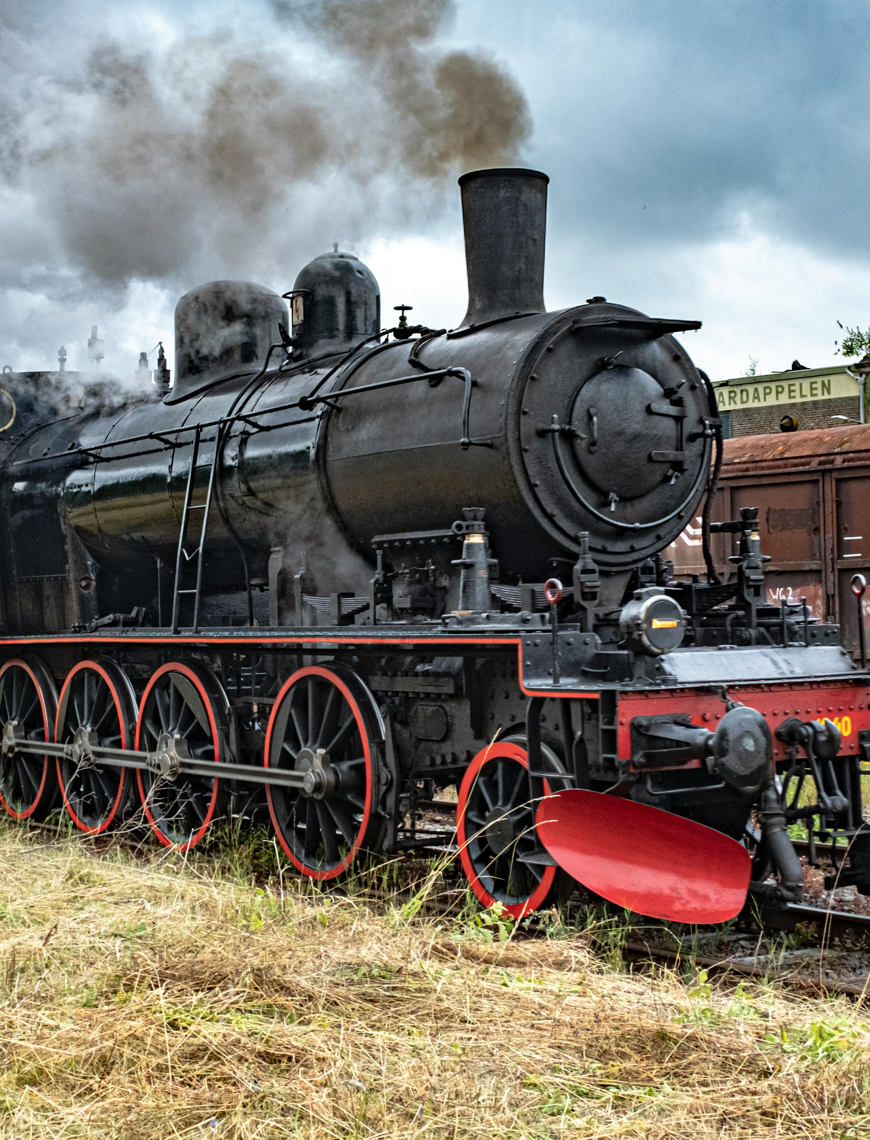
Managing flexible volunteer roles
A whistle stop tour
Develop well-defined roles with specific end points
Recruitment: from inside and out, and make roles bite size, toe-dipping roles, widen your circles
Selection: do not skip selection but does a gardener need 2 written references?
Training evaluate what you have - might rejuvenate your “core” volunteer training
Support – adequate and sustained
Evaluate – look back and change if needed – time bound roles are ideal, get feedback

Slide 15

Quick Idea Share
Ideas to foster flexibility, diversity and dynamic volunteer roles
Name a type of flexibility or dynamic role idea that could be introduced or is already working in your own organisation
Or
Name your favourite dessert

Slide 16

Take away
Note three ideas
as takeaways about
flexibility in volunteering
Zsé Varga
Volunteer Ireland
zse@volunteer.ie
www.volunteer.ie

Slide 17
Thank you
Ask me now or email me later
zse@volunteer.ie
Find out more on volunteer.ie

