Slide 2
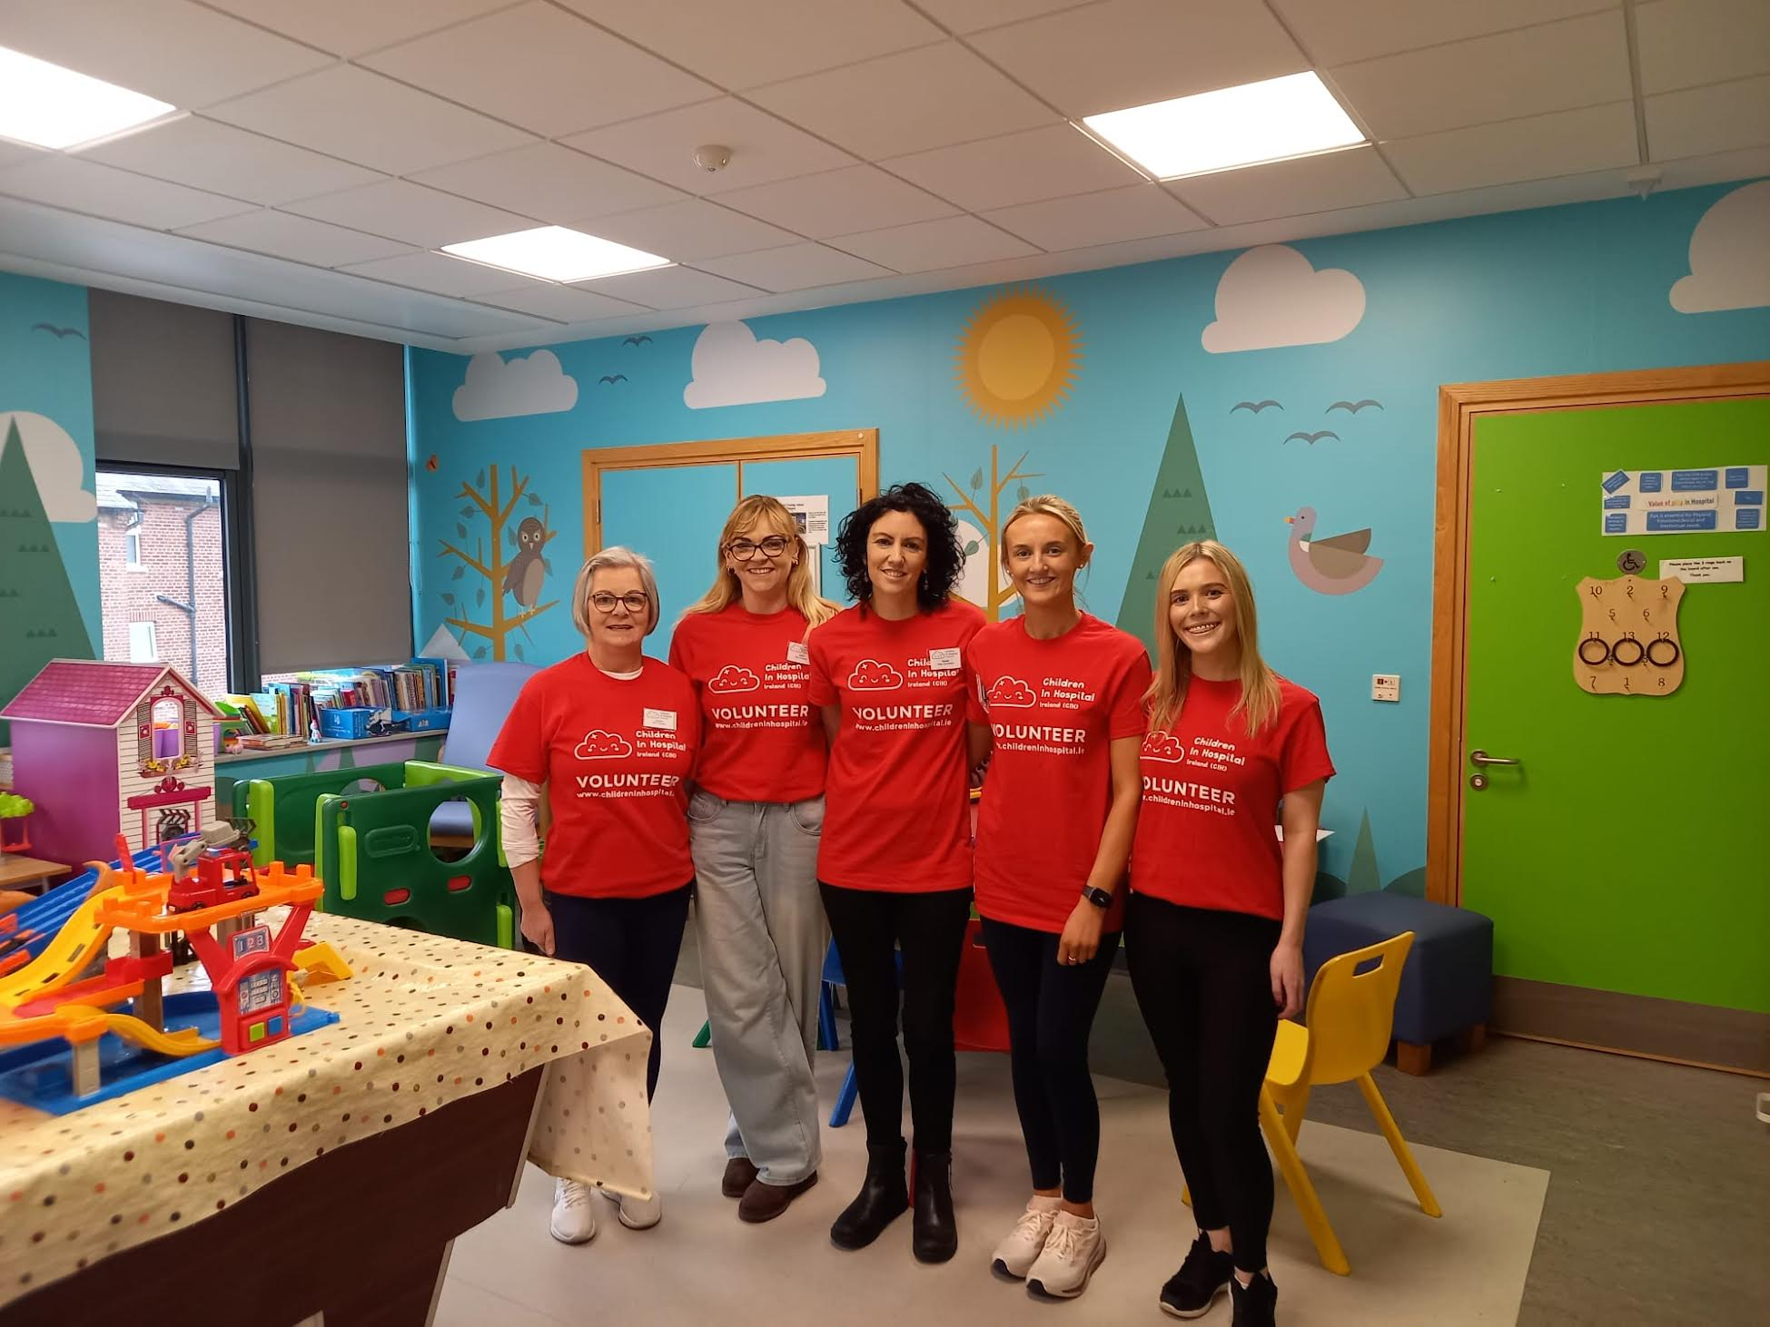
Play, Presence & Purpose: Empowering Hospital Volunteers
The Volunteero Story

Slide 3
James Colclough
Head of Growth
Volunteero
Elizabeth Morrin
Volunteer Manager Children in Hospital

Slide 4
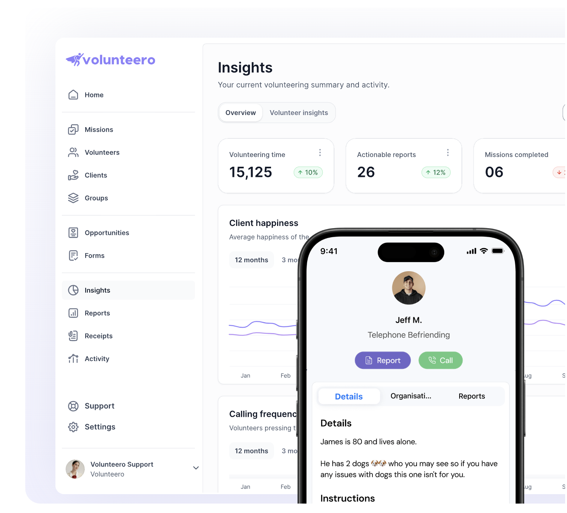
Agenda
- Why Did CIH need a system?
- Challenges
- How Volunteero solved them
- Outcomes
- Advice

Slide 5
Before Volunteero
- Information was in lots of places: “When I first started everything was on paper”
- Delays in communication and reporting: "I was waiting months for time sheets sometimes never got them."
- Too many emails: Lots of back and forth on email and on phone calls to find volunteers.
- No visibility: Difficulty in tracking volunteer hours, activities and any issues

Slide 6
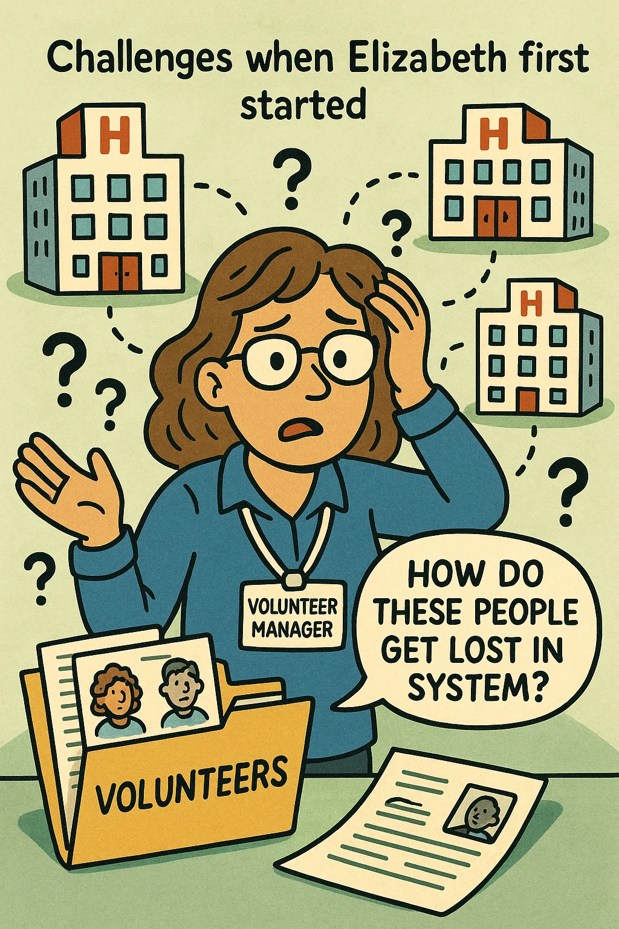
Challenge: Onboarding - Transparency Across the Team
Challenges when Elizabeth first started
No view on whether a volunteer had progressed once passed to their hospital
Was unsure how do people got lost in the system
After (✅ Improved Efficiency):
Now: One place, full visibility.
Anyone on the team can check progress and take action.
Multiple people split work across the process in one system and can see previous actions / notes.

Slide 7
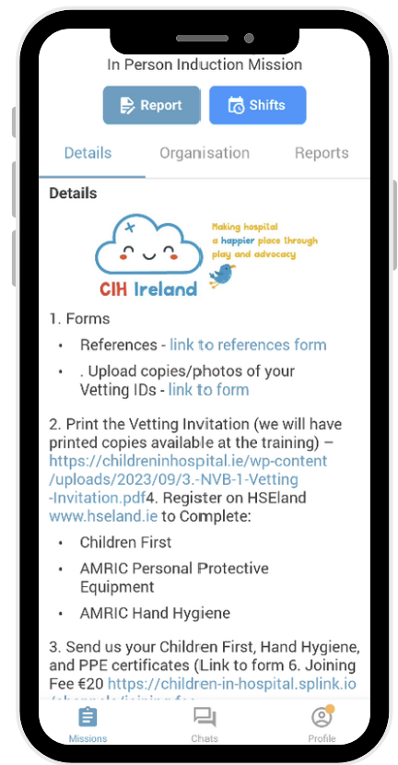
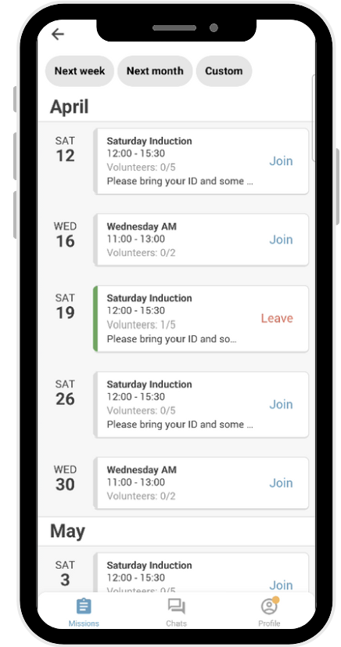
Onboarding Tasks: Using the app to expedite training
📋 Organising Onboarding with Ease
✅ After the interview, successful applicants get their Volunteer App invite
👥 Using the Groups feature to streamline onboarding by team or location
📧 No more email chains – everything lives in one simple UI with a checklist
✉️ Reference requests? Sent automatically with Automated Emails
💡 Pro tip: In the first 30 seconds of the session, do a quick app training & troubleshoot any issues

Slide 8
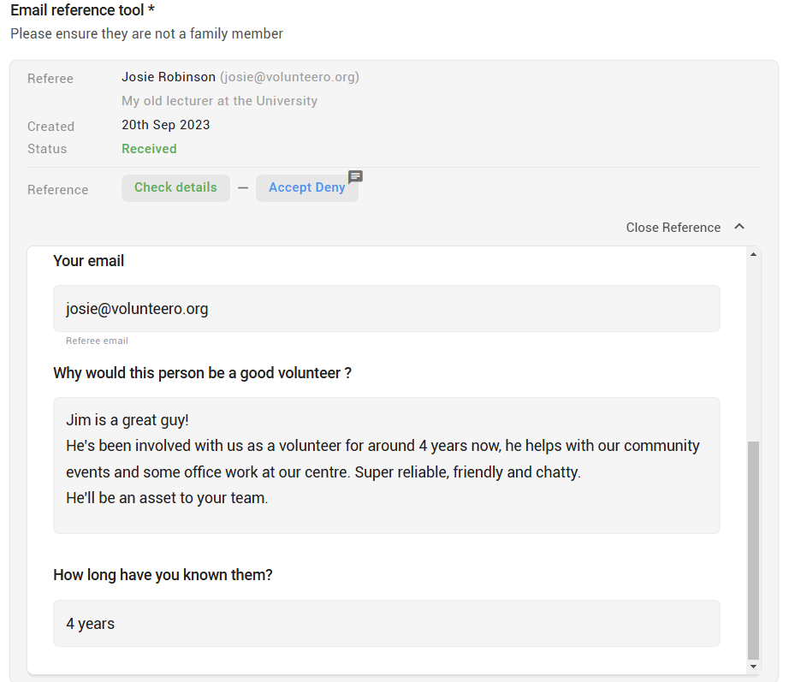
Onboarding: Automated Reference Collection
📩 References are now automatically requested during the application process.
📢 Streamlined Communication: Volunteers are notified about outstanding references during interviews.
📊 Improved Tracking: Clear visibility of received and pending references.
⏳ Reduced Administrative Burden: Minimises manual follow-ups, saving staff time.
Enhanced Volunteer Experience: Volunteers appreciate the clarity and efficiency of the process.
🚀 Overall Efficiency: Contributes to a smoother onboarding experience for new volunteers.

Slide 9
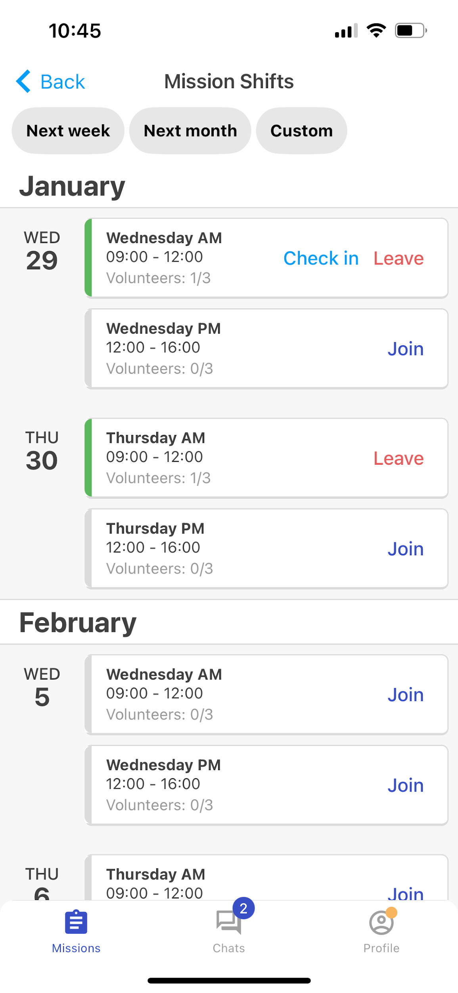
Challenge: Shift management
Before (🚫 Inefficient Process):
🗓️ Manual Scheduling: Shifts took a lot of time to coordinate for over 200 volunteers.
📧 Spreadsheets & Emails: Led to confusion and delays in scheduling.
⏳ Inefficient Communication: Volunteers waited for shift confirmations, causing uncertainty.
🔄 Confirmations: Staff spent considerable time chasing confirmations and managing schedules.
After (✅ Improved Efficiency):
⚡ Instant Shift Posting: Shifts are posted in seconds with real-time updates for volunteers.
📅 Self-Management: Volunteers manage their own availability, reducing staff involvement.
⏱️ Enhanced Efficiency: Cuts down on admin time, allowing staff to focus on volunteer engagement.
🙌 Improved Engagement: Volunteers do more due to easy access to shifts that fit their schedules.
📢 Streamlined Communication: Ensures timely updates and better communication with volunteers.

Slide 10
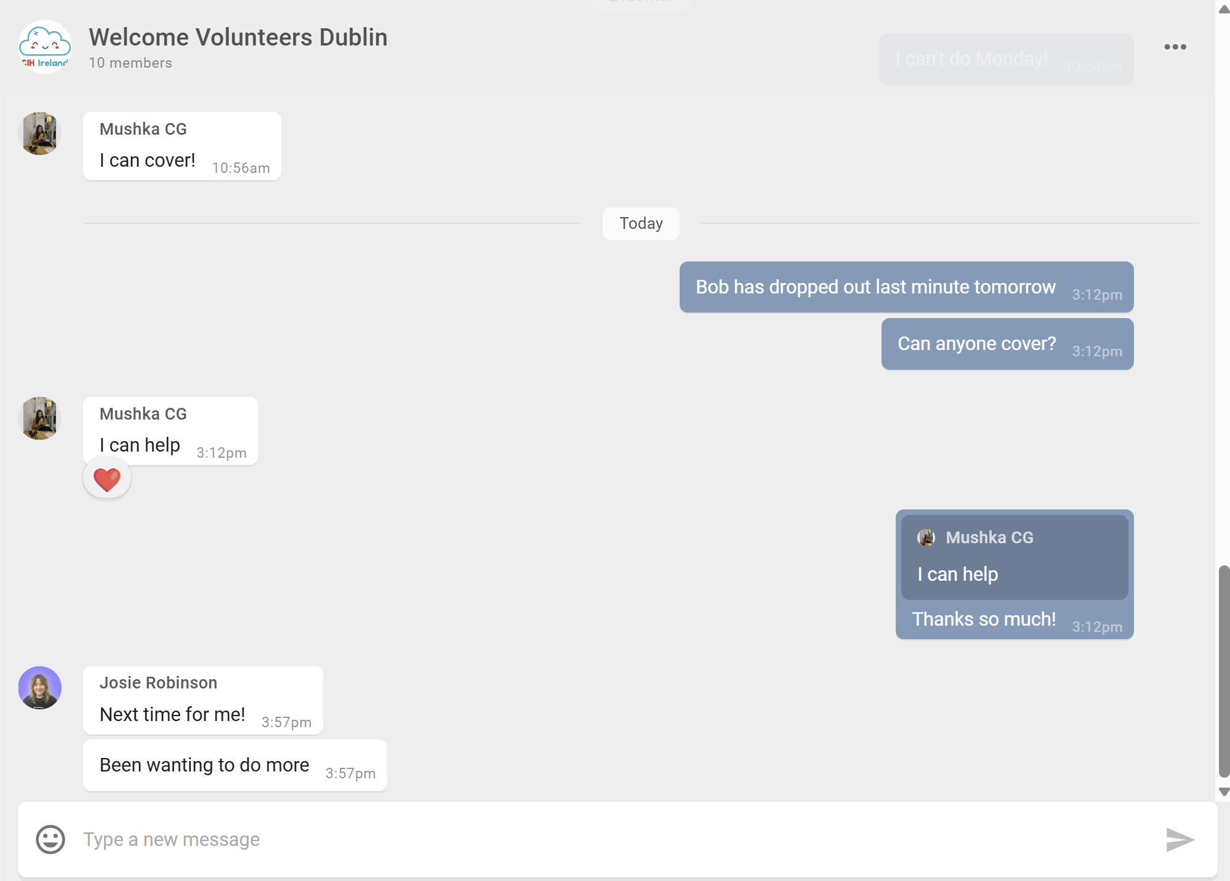
Chat + Shifts = Seamless Volunteering
🧑‍🤝‍🧑 Chat keeps the team connected – volunteers can quickly communicate about shift changes
🔁 Need to swap a shift? Just drop a message in the group – someone else can pick it up instantly
🤝 Especially useful for buddy systems and teams with safeguarding requirements
🕒 Reduces coordinator workload – volunteers manage their own availability
⏳ Real-time updates = no more chasing or confusion
“One person drops a message, leaves the shift, and the other picks it up – done!”

Slide 11
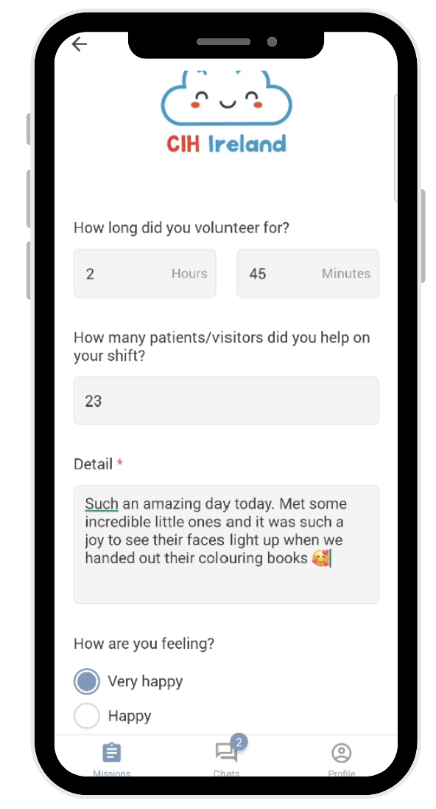
Challenge: Lack of feedback from Volunteers
Before (🚫 Inefficient Process):
📝 Paper-based reports and manual issue tracking.
⏳ Delays in identifying and addressing volunteer concerns.
📂 Reports scattered across multiple systems, making insights harder to track.
After (✅ Improved Efficiency):
📡 Centralized digital reporting system for easy tracking.
⏱️ Real-time monitoring of volunteer issues and escalations.
📈 Quick access to reports, helping managers make better decisions faster.
🏔️One new challenge: With this is the wealth of information can mean you end up diving in too deep.
“I do often find myself needing to pull out of this rabbit hole”

Slide 12
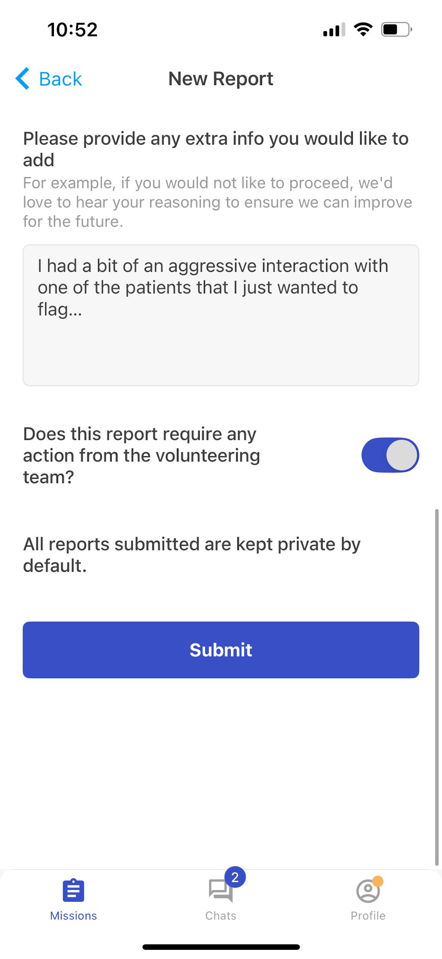
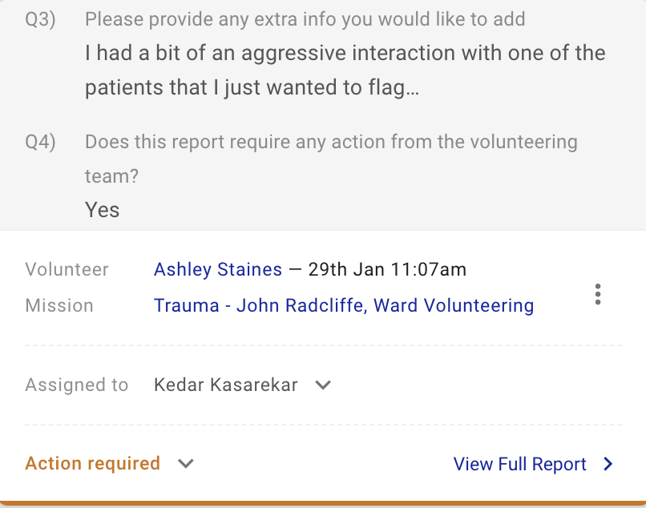
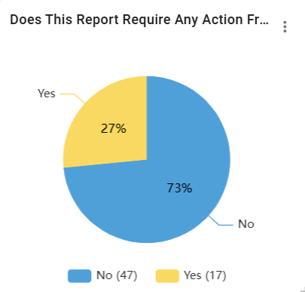
Challenge: Safeguarding Issues
"We’ve had more safeguarding issues, but that doesn’t mean it has increased, just that we are now finally hearing of them"
🚨 The Challenge (Before Volunteero)
🫥 Lack of awareness on the total number of safeguarding issues
🏥 Covering multiple sites meant volunteers were often unseen, delaying responses.
📉 Lack of real-time reporting made urgent action difficult.
✅ The Solution (With Volunteero)
🚀 Instant safeguarding alerts sent directly to the right person.
⏱ Faster response times – issues can be actioned immediately.
📝 Volunteers can share exactly what happened and how they felt.
🔍 All reports are recorded, ensuring accountability and follow-up.

Slide 13
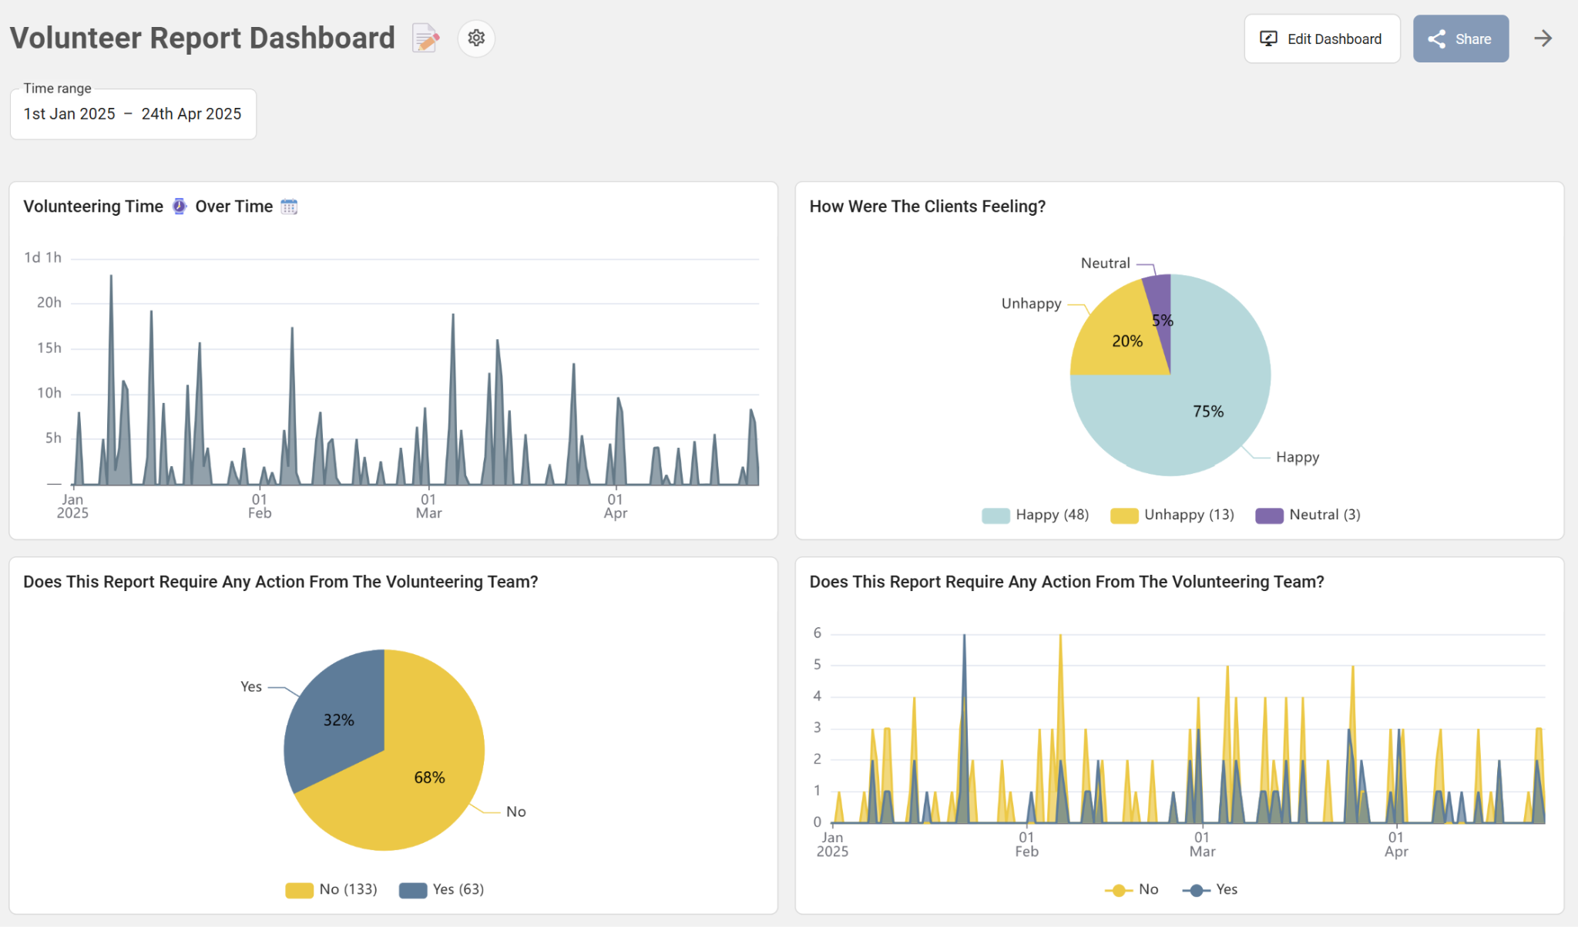
Not Just Data – Insight
- Fully Customised Insight Tool
- Effortlessly create custom views
- Real time data
- Parse by any profile field

Slide 14
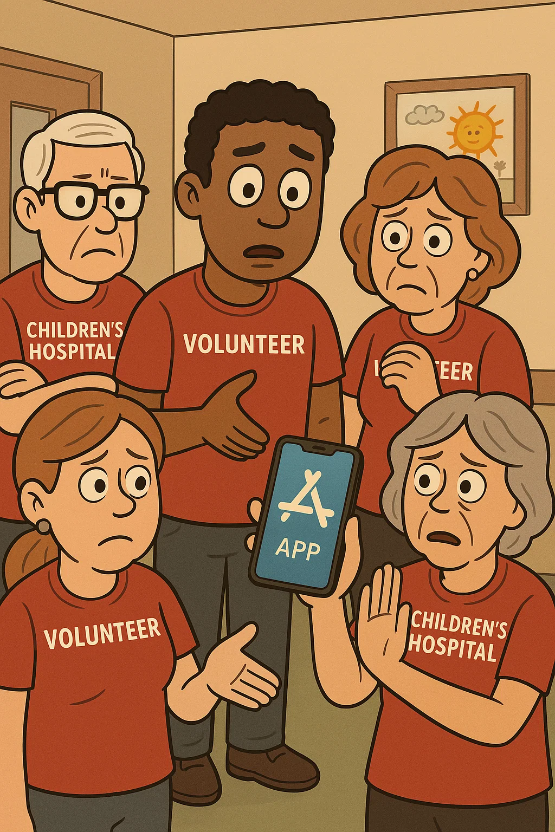
Volunteer Adoption
🚨The Challenge
Some long-standing volunteers took time to adjust to the system.
A small number were hesitant about using an app.
Concerns about volunteers without smartphones accessing the system.
✅ The Solution
Step-by-step video guide saved time and reduced repeated questions.
Gradual adoption led to increasing engagement as more volunteers saw the benefits.
Training during onboarding sessions offered for those needing extra support. One ward has a tech savvy volunteer who gives demonstrations.
📈 The Results
+90% self-service rate for reports and check-ins.
Volunteers now want to be on the app as they see new features and roles.
New starters only know the digital process, making adoption seamless.
Logical transition – after shadowing, they move straight into the app for rotas and shift sign-ups.

Slide 15
Any Advice For Organisations going
through a digital transformation?

Slide 16
Questions?

